Slide 1


Palindrome Detection
Presented by:
Name: Jannatul Firdous Samiya
Id: 222400024
Course code: CSE 314
Course Title: Microprocessor Microcontroller and Assembly language Lab

Slide 2

Overview:
◇ Introdution
◇ Problem Statement
◇ Real Life Approach
◇ Implementation
◇ Code & Output

Slide 3

Key Definition:
Assembly Language: Low-level programming language closely tied to machine code instructions, often used for system programming and real-time applications.
Palindrome: A word, phrase, number, or other sequence of characters that reads the same forward and backward.
Interrupt 21h (INT 21h): A DOS interrupt used to perform various input/output operations, such as reading from the keyboard and displaying messages.

Slide 4

Introduction
To Palindrome
A Palindrome is a word, sentence, verse, or even number that reads the same backward or forward.
Palindromes can also be numeric, such as "12321" or "45654."
Examples of palindromic words include "radar," "level," "madam," "racecar" etc.

Slide 5
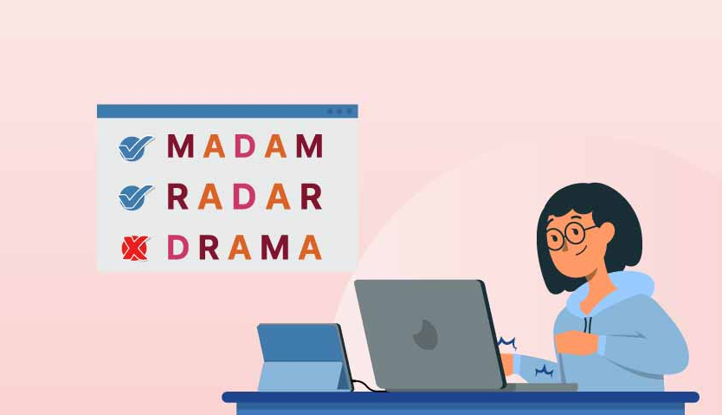
Real Life Approach:
Data Validation: Palindromes ensure data accuracy by confirming symmetry.
Error Detection: Palindromes reveal discrepancies, aiding error identification.
String Processing: Palindromes identify symmetrical patterns, enhancing text analysis.
Security and Cryptography: Palindromic structures bolster encryption and authentication.
Programming and Algorithms: Palindromes inspire efficient coding solutions.

Slide 6

Problem Statement:
Challenge: Detect whether a given string is a palindrome or not.
Input: User-provided string.
Output: Message indicating whether the string is a palindrome or not.

Slide 7
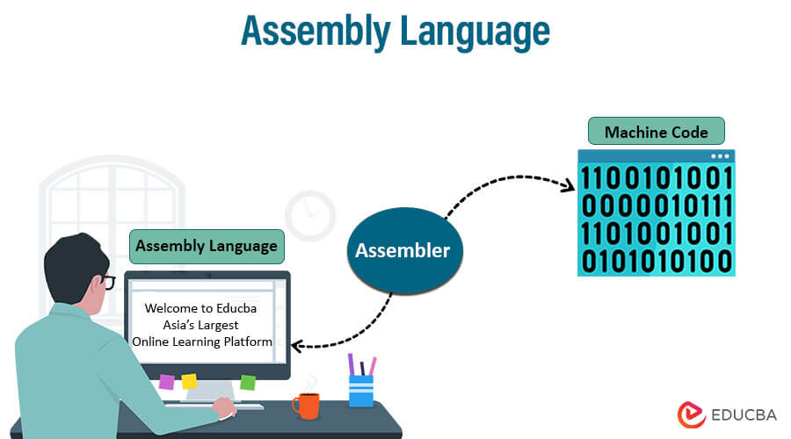
Implementation:
Initialization: Set up data segment.
Input: Prompt user for a string and read it.
Length Calculation: Determine the length of the string.
Palindrome Check: Compare characters from both ends of the string towards the center, ignoring spaces.
Output: Display whether the string is a palindrome or not.
Exit: Terminate the program.

Slide 8
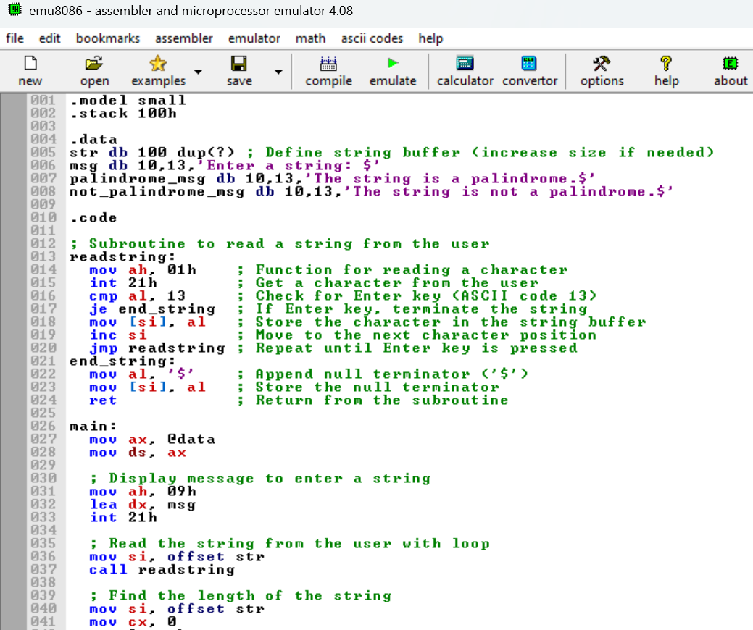
Code:

Slide 9
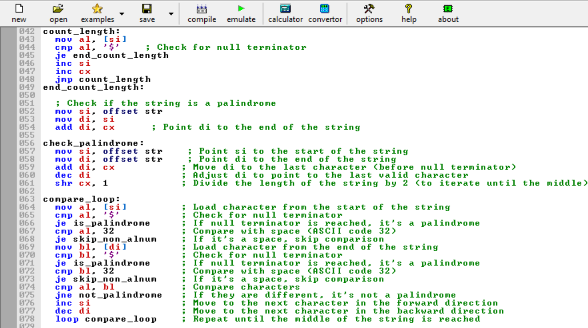
Code:

Slide 10
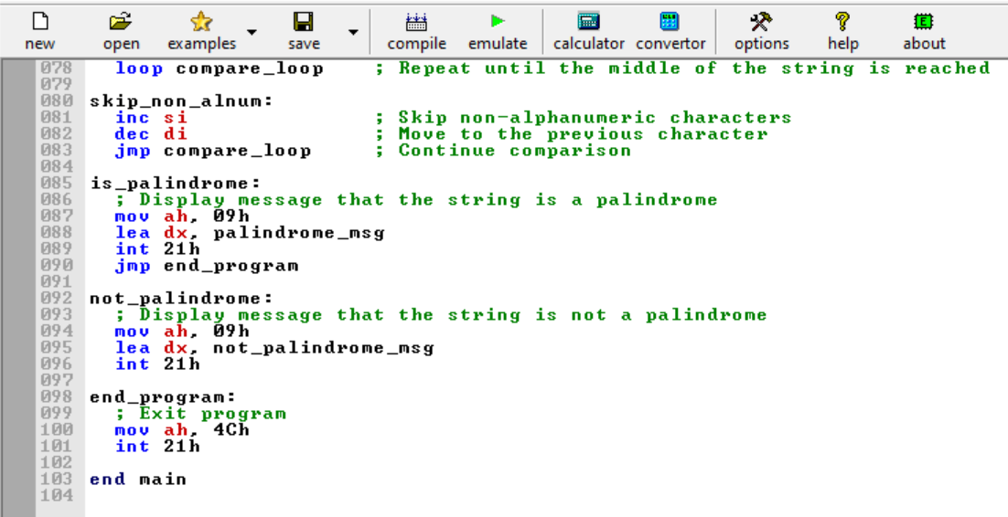
Code:

Slide 11
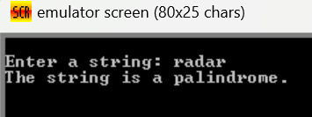
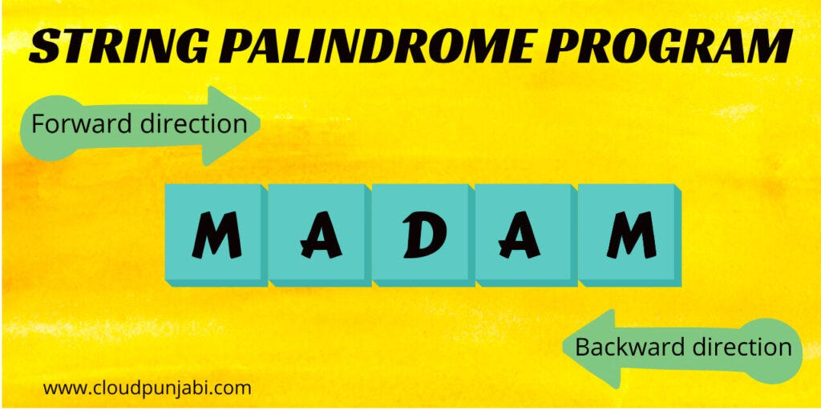
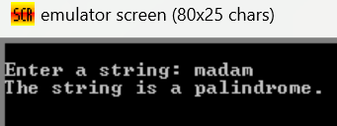
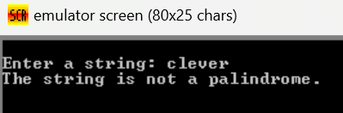
Output:

Slide 12


